Slide 1
SEO PROJECT
Comprehensive SEO Audit & Optimization for Organic Traffic Growth
Mesack Milton | MBT11

Slide 2
EXECUTIVE SUMMARY
This SEO audit report for Tech Mahindra's website ( https://www.techmahindra.com/ ) provides a detailed analysis of the site's current SEO performance, including its strengths and weaknesses. The audit was conducted to enhance the website’s visibility, search engine ranking, and overall user experience. The report covers a comprehensive SEO audit, keyword research, on-page and technical SEO analysis, and strategic recommendations for improvement.

Slide 3
ABOUT THE COMPANY
Tech Mahindra is a leading provider of digital transformation, consulting, and business re-engineering solutions, part of the multi-billion dollar Mahindra Group. With over 160,000 professionals across 90 countries, the company serves a wide range of industries, including telecommunications, healthcare, banking, and manufacturing.

Slide 4
Core services
Digital Transformation
Consulting
Business Re-Engineering
Enterprise Solutions
AI & Data Analytics
Cloud Services
Cybersecurity
Industries Served
Telecommunications
Healthcare
Banking & Financial Services
Manufacturing
Energy & utilities
Automotive
Commitment: Innovation And Excellence For Sustainable Growth

Slide 5
INITIAL SEO AUDIT
Selected pages
Banking and Financial Services
Oil and Gas
Travel, Transportation, Logistics, Hospitality (TTLH)

Slide 6
CURRENT PERFORMANCE OVERVIEW
1. https://www.techmahindra.com/industries/banking-financial-services/
Visibility and Rankings:
Indexed Pages: The page is indexed by Google, but it does not rank highly for competitive keywords in the banking and financial services industry.
Traffic Overview: The page appears to attract low organic traffic due to limited visibility in search results.

Slide 7
Key Strength
Key Weakness
Strong domain authority DA-61/100 (moz.com)
Comprehensive service offerings across multiple industries
Secure HTTPS Connection
Clean and User-Friendly Design
Low page speed scores, particularly on mobile devices
Limited keyword in the content
Absence of Meta Description
Potential technical SEO issues impacting performance

Slide 8
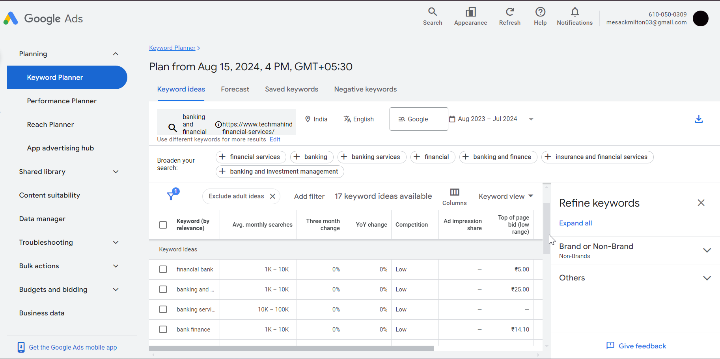
KEYWORD RESEARCH
Targeted Keyword: banking and financial services
Tool: Google Keyword Planner
a. High Volume & low competition Keywords
banking services
financial services
finance company
commercial banking
banking financial services
banking and finance
financial bank
bank finance

Slide 9
The keywords are based on common industry terms and search trends relevant to the Banking, Financial Services, and Insurance (BFSI) sector.
1. Primary Keywords:
Banking IT Services
Financial Technology Solutions
Digital Banking Transformation
Banking and Financial Services
Secondary Keywords:
AI in Banking
Blockchain in Finance
Cloud Banking Solutions
Cybersecurity in Banking

Slide 10
3. Long-Tail Keywords:
How AI is transforming the banking sector
Top digital transformation trends in banking
Cybersecurity challenges in financial services
Benefits of cloud adoption in banking

Slide 11
COMPETITOR KEYWORD ANALYSIS
b. Identified Competitors
TCS (Tata Consultancy Services)
Website: www.tcs.com
Keywords: "Banking IT solutions", "Digital banking transformation", "Financial services consulting"
Strategy: TCS focuses on keywords related to comprehensive banking solutions, digital transformation, and consulting services. Their content strategy emphasizes thought leadership and detailed case studies.
Infosys
Website: www.infosys.com
Keywords: "Fintech consulting", "AI in banking", "Cloud banking solutions"
Strategy: Infosys targets emerging technology trends in banking, such as AI and cloud computing, positioning itself as a forward-thinking innovator.
Wipro
Website: www.wipro.com
Keywords: "Banking cybersecurity", "API banking platforms", "Digital banking experiences"
Strategy: Wipro leverages keywords focused on security and customer experience in banking, highlighting their expertise in building secure and user-friendly platforms.

Slide 12
Competitor Strategies
Content Focus: Competitors are heavily investing in content marketing, focusing on blog articles, whitepapers, and webinars covering the latest trends and innovations in banking technology.
Keyword Variability: They use a mix of high-volume and niche keywords to capture a broader audience and reduce reliance on highly competitive terms.
Thought Leadership: Competitors are establishing themselves as thought leaders by publishing insights and analyses on industry trends, positioning themselves as experts in the field.

Slide 13
ON-PAGE SEO ANALYSIS
1. Title Tags, Meta Descriptions, and HTML Tags
Tool: SEO META in 1 click (chrome extension)
a. Title Tags
a.1 Current Title Tag: “Banking and Financial Services | Tech Mahindra”
a.2 Length: 46 characters
a.3 Analysis:
The title tag is within the recommended length of 50-60 characters.
The title includes important keyword like “Banking & Financial Services” and a brand name

Slide 14
a.4 Recommendation:
Ensure the title includes keywords that your target audience is searching for. For instance, you might want to include terms like "digital transformation," "financial technology," or "banking solutions.“
Placing the brand name at the end is generally a good practice, but sometimes placing it at the beginning or using a different structure can improve visibility.
Example Title Tags:
“Digital Banking & Financial Services Solutions | Tech Mahindra”
Keywords: "Digital Banking," "Financial Services Solutions"
Length: 60 characters

Slide 15
2. “Tech Mahindra: Leading Banking & Financial Technology Solutions”
Keywords: "Banking," "Financial Technology Solutions"
Length: 60 characters
3. “Innovative Financial Services & Banking Solutions | Tech Mahindra”
Keywords: "Innovative Financial Services," "Banking Solutions"
Length: 62 characters

Slide 16
b. Meta Descriptions
b.1 Current Meta Description: The selected page does not have a meta description.
b.2 Analysis:
The absence of a meta description may leads search engines to automatically generate one from the page content, which can be less effective in attracting clicks.
Recommendation:
Create a specific meta description to enhance click-through rates by providing a concise and accurate summary of the page's content. For example:
“Discover Tech Mahindra’s cutting-edge digital banking and financial services solutions designed to drive transformation and growth. Explore now!”
Length: 145 characters (within the recommended range of 150-160 characters)

Slide 17
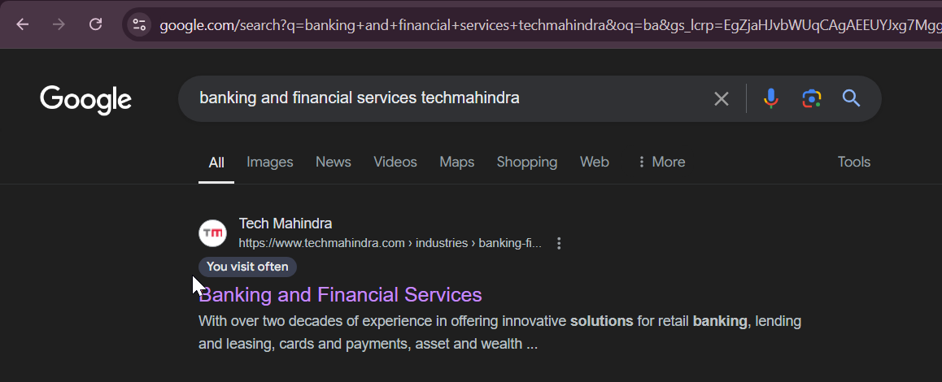
When searching for the page, search engines generate the following snippet from the visible page content. This is not a meta tag

Slide 18
c. HTML Tags
c.1 Header Tags (H1, H2, H3):
H1 Tag: “Banking and Financial Services”
Analysis: The H1 tag is clear and contains the primary keyword. However, it is quite broad and does not specify the unique value or services that Tech Mahindra offers in this sector
H2 Tags: Include “Our Services,” “Why Choose Tech Mahindra,” “Case Studies,” and “Contact Us.”
Analysis: These tags effectively structure the content but could include more keyword variations.
c.2 Recommendation:
Use more keyword-rich variations in H2 and H3 tags, such as “AI-Driven Financial Services” ,“Cloud Banking Solutions.” , “Customer Success Stories in Banking Technology”
H3 Tags: Limited use of keywords in H3 tags.
Analysis: Found under sections like “Our Services,” but are underutilized

Slide 19
2. Keyword Usage in Content and Headings
The keyword “Banking and Financial Services" is optimized in the title and headings but not present in the content.
Content Alignment:
Current Status: The content generally aligns with broad industry terms like "banking" and "financial services" but lacks specificity.
Keyword Density: The page does not use high-volume, industry-specific keywords effectively.
Content Depth: Content is somewhat general and lacks detailed explanations or case studies on specific solutions offered.

Slide 20
Individual Keywords: (Without Heading)
"Banking": Present 17 times (high frequency).
"Financial": Present once.
"Financial Services": Present once.
“Services”: present 30 times
Optimization Status
The page is not fully optimized for the keyword phrase "Banking and Financial Services."

Slide 21
Reasons:
1. The primary keyword phrase is missing from the content body. For optimization, this phrase should be included throughout the content.
2. The keyword "banking" appears too frequently, which may lead to keyword stuffing and negatively affect readability and SEO.
3. The terms "financial" and "financial services" are underrepresented in the content, which limits their impact on SEO.

Slide 22
3.Internal and External Linking
Tools: SEOMator , DNS CHECKER
3.a Internal Links
Total links: 263
Internal Links: 247
Distribution: The internal links are distributed throughout the page in various sections, including the navigation menu, content body, and footer.
3.b External Links
External Links: 16
Nofollow external: 5
Distribution: External links are present in the main content

Slide 23
Opportunities for Improvement
3.c Internal Linking Suggestions
Use descriptive and keyword-rich anchor texts for internal links to improve SEO and provide context.
Incorporate links to informational content, such as blog posts or whitepapers on topics
3.d External Linking Suggestions
Include links to industry-leading publications, reports, or organizations that provide valuable insights into banking and financial services.
To enhance user experience, ensure that external links open in new tabs, preventing users from navigating away from Tech Mahindra’s site.

Slide 24
4. Image Optimization Status
Images are properly optimized with alt texts, but their file names are generic.
Recommendation
Rename image files to be more descriptive and keyword-rich.
Avoid using generic names (e.g., image1.jpg) and instead use specific, SEO-friendly names (e.g., tech-mahindra-cloud-solutions.jpg).
Use tools to reduce image file sizes without compromising quality.
Use lazy loading techniques to delay the loading of off-screen images until they are needed.

Slide 25
TECHNICAL SEO ANALYSIS
1. Overall Speed of the Desktop Webpage
Current Speed: 4.3 seconds (Largest Contentful Paint)
Recommended Speed: < 2.5 seconds
2. Overall Speed of the Mobile Webpage
Current Speed: 28.0 seconds (Largest Contentful Paint)
Recommended Speed: < 2.5 seconds

Slide 26
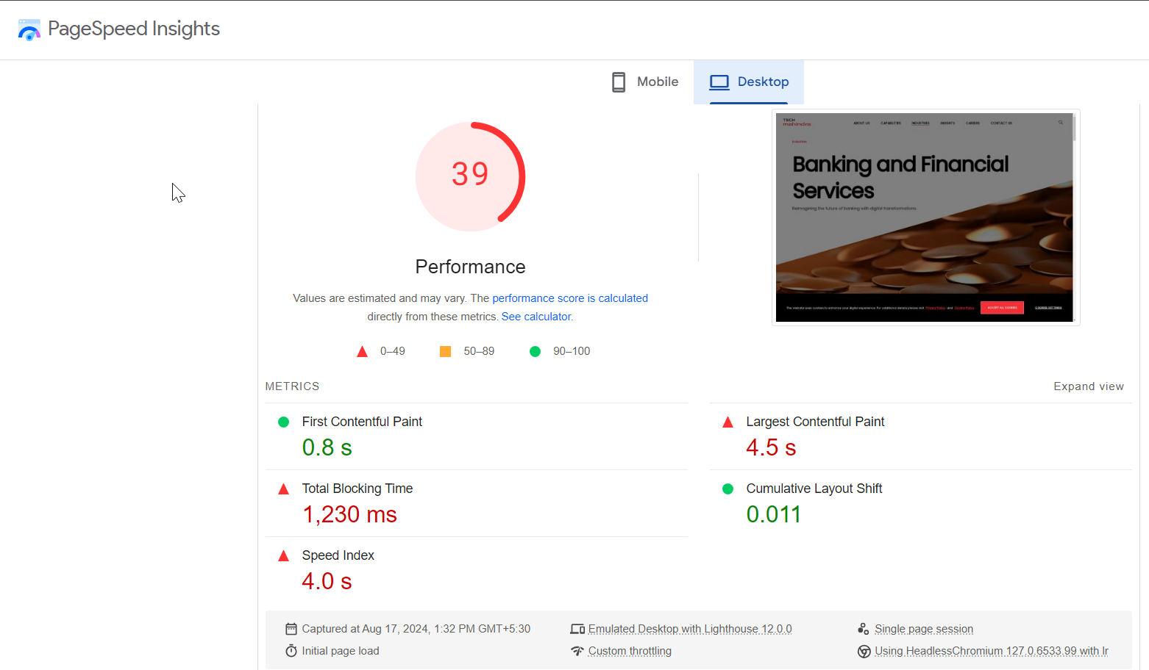
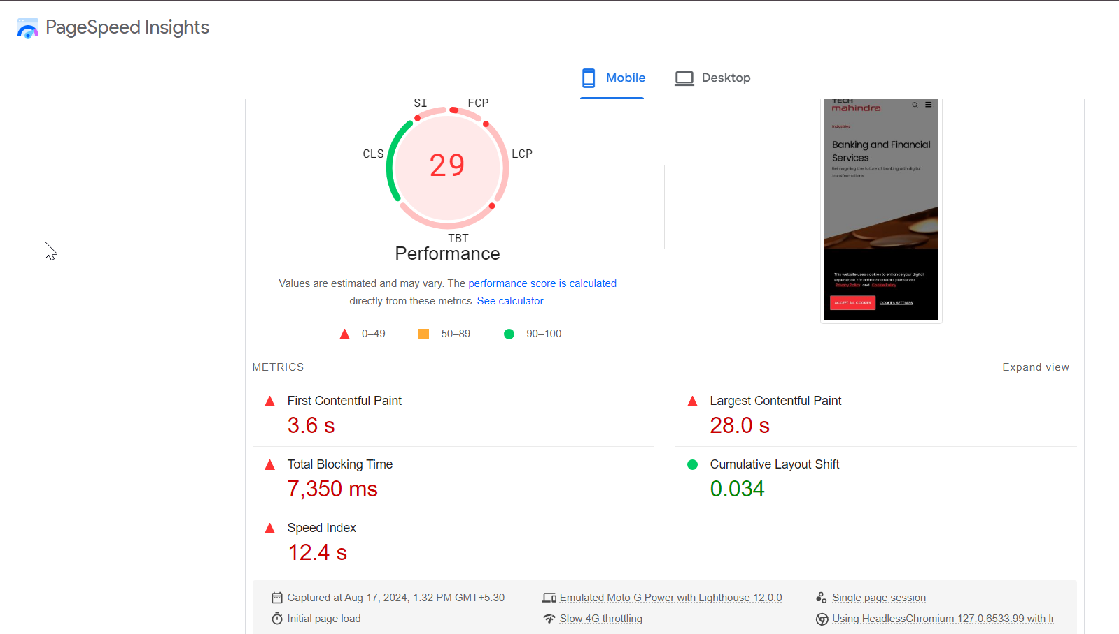
Desktop Score
Mobile Score

Slide 27
Technical SEO Issues on Tech Mahindra Homepage (this is for another two pages)
Low page speed on mobile is a significant issue for SEO and user experience.
The homepage has meta tags but could further optimize the meta descriptions and titles for better rankings.
The Total Blocking Time (TBT): Heavy JavaScript are blocking the page from becoming interactive. This delay in responsiveness negatively impacts user experience and overall page performance.
Some broken link is found

Slide 28
5 Best Practices to Improve Site and Web Page Speed
Use image compression tools to reduce file sizes without sacrificing quality. Implement responsive images and serve different sizes based on the device.
Reduce the size of JavaScript and CSS files by minifying and combining them to decrease page load time.
Apply lazy loading to offscreen images and videos to reduce initial load time.
Use a CDN to distribute content across multiple servers globally, reducing latency and speeding up load times for users.
Optimize server performance by using efficient hosting solutions, optimizing databases, and utilizing server-side caching.

Slide 29
CONTENT STRATEGY RECOMMENDATIONS
Develop comprehensive articles focused on each primary keyword, such as “Digital Transformation in Banking: How Tech Mahindra Leads the Way.”
Include detailed case studies, client testimonials, and real-world applications to establish authority and attract high-intent traffic.
Update existing content to include secondary keywords and relevant long-tail keywords. This will help capture more specific search queries and improve the page’s relevance.
BFSI is a rapidly evolving sector. Regularly update content to reflect the latest trends, regulations, and technological advancements.

Slide 30
OFF PAGE SEO ANALYSIS
1. Backlink profile
Backlinks: The selected page does not currently have any direct backlinks.
Domain Backlinks: The Tech Mahindra domain has a strong backlink profile with numerous high-quality links, but these do not currently point to the Banking and Financial Services page.

Slide 31
2. Social Media presence
Here are the official social media accounts for Tech Mahindra:
LinkedIn: [Tech Mahindra LinkedIn]
Twitter: [Tech Mahindra Twitter]
Facebook: [Tech Mahindra Facebook]
Instagram: [Tech Mahindra Instagram]
YouTube: [Tech Mahindra YouTube]
These are the primary platforms Tech Mahindra actively uses.

Slide 32
The selected page has limited direct engagement on social media platforms.
There are few social signals directly linked to this page. Increasing social engagement could enhance visibility and traffic
3. Online Reputation and Reviews
Tech Mahindra is well-recognized in the industry, but specific mentions and reviews related to the Banking and Financial Services page are minimal.
General customer reviews about Tech Mahindra’s services are positive but do not specifically address the Banking and Financial Services page.

Slide 33
4. Local SEO
Local Listings: The selected page (Banking and Financial Services) does not typically focus on local SEO because it targets a broader, global audience.
Google My Business: The profile is active, but it does not directly link to the Banking and Financial Services page, as this profile typically highlights the company's main offerings rather than specific service pages.

Slide 34
Off page SEO plan
1. Build Backlinks to the Selected Page:
Reach out to industry blogs, financial services websites, and news platforms for guest blogging opportunities that can include links to the Banking and Financial Services page.
Utilize relationships with industry partners, clients, and stakeholders to gain backlinks from related content and articles.
Develop and promote high-quality, shareable content such as case studies, infographics, and white papers relevant to banking and financial services.

Slide 35
2. Increase Social Media Engagement:
Actively share content related to the Banking and Financial Services page across Tech Mahindra’s social media channels.
Increase engagement by encouraging discussions, sharing industry insights, and creating interactive content such as polls and Q&A sessions.
3. Enhance Online Reputation and Reviews:
Request reviews and testimonials from clients and partners specifically mentioning Tech Mahindra’s banking and financial services.
Share detailed case studies and success stories on review platforms and industry forums to improve credibility and attract backlinks.

Slide 36
4. Optimize for Local SEO:
Develop content that targets specific local markets or regions relevant to banking and financial services to improve local search visibility
Ensure the Google My Business profile links to the Banking and Financial Services page and includes updated and relevant content.

Slide 37
CURRENT PERFORMANCE OVERVIEW
2. https://www.techmahindra.com/industries/oil-and-gas/
Visibility and Rankings:
Indexed Pages: The page is indexed by Google, but it does not rank highly for competitive keywords in the Oil and Gas industry.
Traffic Overview: The page appears to attract low organic traffic due to limited visibility in search results.

Slide 38
Key Strength
Key Weakness
Strong domain authority DA-61/100 (moz.com)
The keyword "Oil and Gas" appears three times and is well-optimized
Secure HTTPS Connection
Clean and User-Friendly Design
The title of the page is quite short
The page speed, especially on mobile devices, is slower than ideal
Absence of Meta Description
Potential technical SEO issues impacting performance

Slide 39
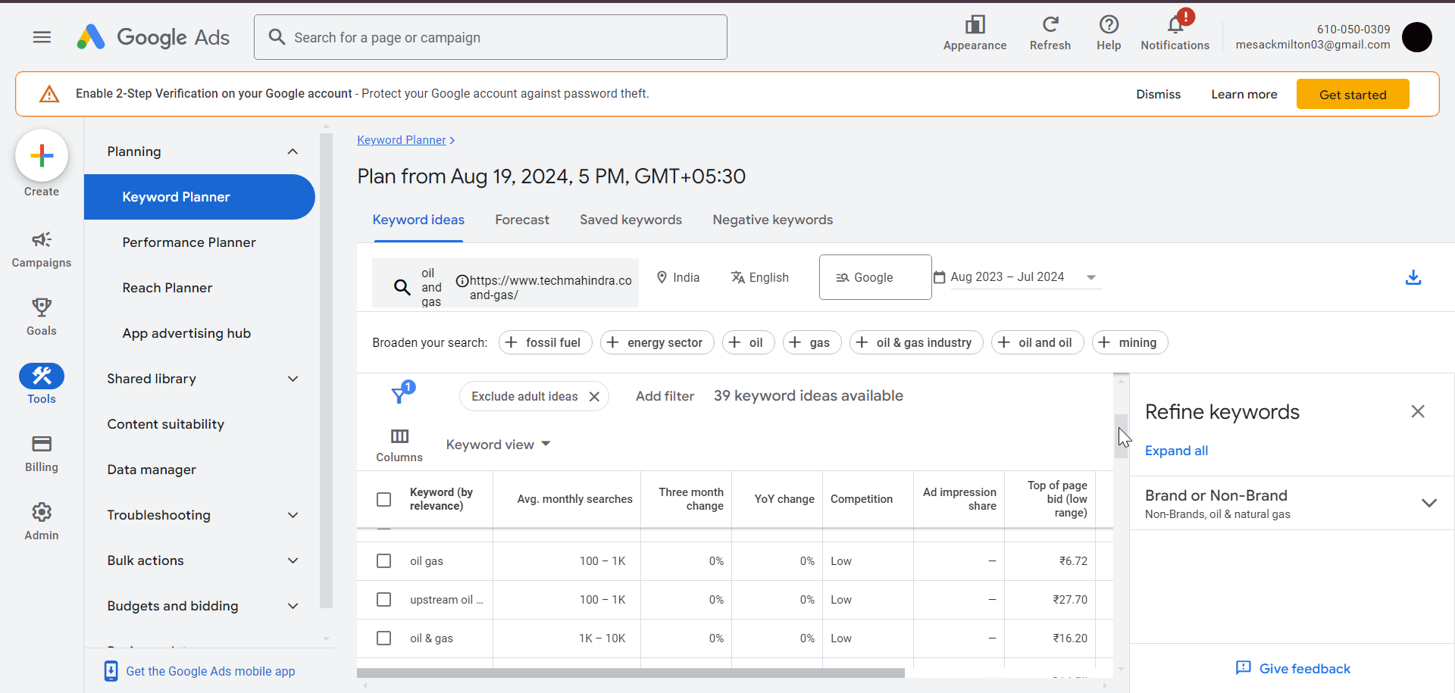
KEYWORD RESEARCH
Targeted Keyword: Oil and Gas
1. High Volume & low competition Keywords
oil and gas industry
oil gas on
oil & gas
oil and gas technology
oil & gas industry
oil and gas sector
oil & gas sector
oil & natural gas

Slide 40
2. Keywords for the Oil and Gas Industry:
2.a Primary Keywords:
Oil and Gas Industry Solutions
Digital Transformation in Oil and Gas
Oil and Gas Technology
Oil and Gas Services
2.b Secondary Keywords:
Oil and Gas Consulting
Oil and Gas Industry Trends
Digital Solutions for Oil and Gas
2.c Long-Tail Keywords:
Innovative Digital Solutions for Oil and Gas
Oil and Gas Industry Automation Services
Advanced Technology for Oil and Gas Operations
Oil and Gas Industry IT Solutions

Slide 41
COMPETITOR KEYWORD ANALYSIS
1. Competitors Identified:
Competitor 1: IBM
Competitor 2: Accenture
Competitor 3: TCS
2. Competitor Keywords:
"Oil and Gas Industry 4.0"
"Energy Digital Transformation"
"AI in Oil and Gas"
"Operational Efficiency in Oil and Gas"

Slide 42
Competitor Strategies:
Competitors are heavily focused on addressing specific industry challenges, such as improving operational efficiency, sustainability initiatives, and the adoption of AI-driven solutions in the Oil & Gas sector.
Competitors often showcase detailed case studies that highlight successful digital transformation projects. These case studies serve as proof of their capabilities and demonstrate the real-world impact of their solutions.
Competitors use SEO tactics that include creating detailed articles, publishing whitepapers, and utilizing case studies. These content types are optimized for industry-specific keywords, helping them to rank well in search results and attract targeted traffic.

Slide 43
ON-PAGE SEO ANALYSIS
1. Title Tags, Meta Descriptions, and HTML Tags
Tool: SEO META in 1 click
a. Title Tags
a.1 Current Title Tag: “Oil and Gas | Tech Mahindra”
a.2 Length: 27 characters
a.3 Analysis:
The current title tag is concise, but it is somewhat generic, using only "Oil and Gas," which broadly describes the industry without indicating the specific focus of the page.

Slide 44
The title lacks specific, high-impact keywords that would better align with the page’s content, such as "Digital Transformation" or "Industry Solutions."
At 27 characters, the title is on the shorter side, allowing room to add more specific keywords without exceeding the recommended 50-60 character limit
Suggested Title Optimization
Option 1: "Oil and Gas Solutions | Tech Mahindra"
Length: 42 characters

Slide 45
Benefits: This title adds the company name and the word "Solutions," which provides a clearer idea of what the page is about. It also includes a brand mention, which can enhance credibility and attract clicks.
Option 2: "Innovative Oil and Gas Services | Tech Mahindra"
Length: 52 characters
Benefits: This version adds "Innovative" to highlight the unique aspect of the services provided and includes the company name, making the title more descriptive and engaging.

Slide 46
Option 3: "Oil and Gas Industry Expertise | Tech Mahindra"
Length: 48 characters
Benefits: This title emphasizes "Industry Expertise," which can appeal to users looking for knowledgeable providers in the Oil and Gas sector.
b. Meta Descriptions
b.1 Current Meta Description: The selected page does not have a meta description.
b.2 Analysis:
The absence of a meta description may leads search engines to automatically generate one from the page content, which can be less effective in attracting clicks.

Slide 47
Meta descriptions serve as a preview of the page’s content, helping users determine if the page matches their search intent. Without one, users may be less inclined to click through.
Recommendation:
Add a meta description that highlights the page’s value proposition and includes key phrases.
Reference: “ Discover how Tech Mahindra's AI-driven solutions transform the oil and gas industry. Enhance operational efficiency and drive sustainability with our cutting-edge technologies.”

Slide 48
c. HTML Tags
c.1 H1 Tag:
Current H1 Tag: "Oil and Gas"
Analysis: The H1 tag is too broad and does not reflect the specific focus of the page.
Recommendation: Update the H1 tag to be more descriptive and include relevant keywords.
Example: Change the H1 tag to “Digital Transformation Solutions for the Oil and Gas Industry” to better align with the page’s content and improve SEO.
c.2 Heading Structure (H2/H3 Tags):
Current Status: The headings are not optimized with keywords, and the structure is inconsistent.

Slide 49
Recommendation: Organize headings with a logical hierarchy and include relevant keywords.
Example: Use H2 tags like “AI in Oil and Gas,” “Sustainable Energy Solutions,” and H3 tags like “Case Studies” or “Client Success Stories” to create a well-structured page that is easier for search engines to crawl and users to navigate.

Slide 50
2. Keyword Usage in Content and Headings
The keyword “Oil and Gas" is optimized in the title, headings and the content.
Keyword Density:
The page does not effectively use high-volume, industry-specific keywords such as "AI-driven solutions," "digital transformation in oil and gas," and "automation in energy sector."
Content Depth:
The content is somewhat general and lacks detailed explanations or case studies showcasing how Tech Mahindra’s solutions are applied within the oil and gas industry.

Slide 51
3. Internal and External Linking
3.a Internal Links
Total links: 200
Internal Links: 191
Analysis: Integrate internal links within the content that direct users to related services or solutions offered by Tech Mahindra in the oil and gas industry.
3.b External Links
External Links: 9
Nofollow external: 5
Analysis: Include external links to trusted industry sources, such as government reports, industry whitepapers, or news articles. This can enhance the credibility of the content and help position Tech Mahindra as a thought leader in the oil and gas sector.

Slide 52
4. Image Optimization Status
Images are properly optimized with alt texts, but their file names are generic.
Recommendation
Rename image files to be more descriptive and keyword-rich.
Avoid using generic names (e.g., image1.jpg) and instead use specific, SEO-friendly names (e.g., tech-mahindra-cloud-solutions.jpg).
Use tools to reduce image file sizes without compromising quality.
Use lazy loading techniques to delay the loading of off-screen images until they are needed.

Slide 53
TECHNICAL SEO ANALYSIS
Overall Speed of the Desktop Webpage
Current Speed: 3.9 seconds (Largest Contentful Paint)
Recommended Speed: < 2.5 seconds
Overall Speed of the Mobile Webpage
Current Speed: 22.0 seconds (Largest Contentful Paint)
Recommended Speed: < 2.5 seconds

Slide 54
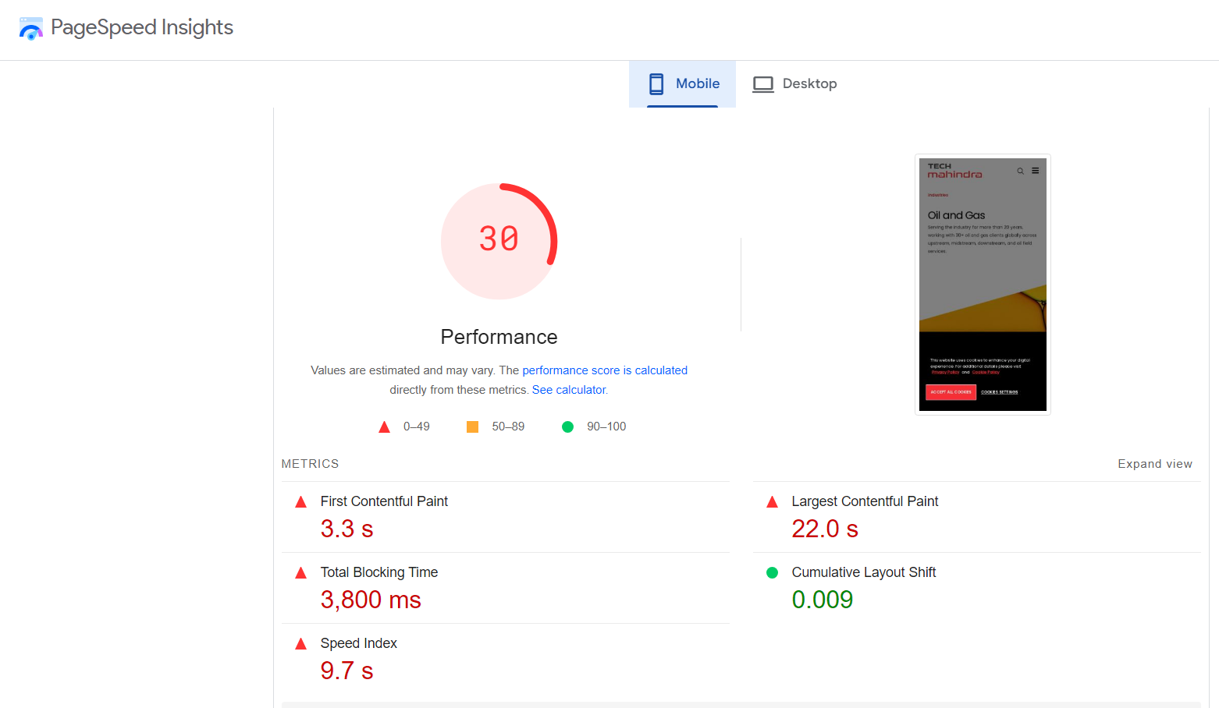
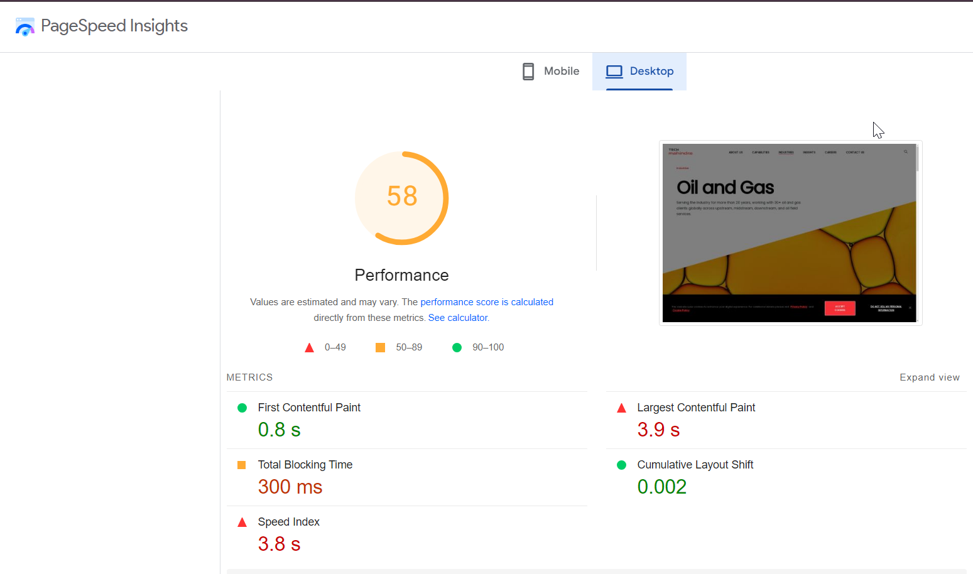
Mobile Score
Desktop Score

Slide 55
5 Best Practices to Improve Site and Web Page Speed
Use image compression tools to reduce file sizes without sacrificing quality. Implement responsive images and serve different sizes based on the device.
Reduce the size of JavaScript and CSS files by minifying and combining them to decrease page load time.
Apply lazy loading to offscreen images and videos to reduce initial load time.
Optimize server performance by using efficient hosting solutions, optimizing databases, and utilizing server-side caching.
Improve by reducing render-blocking resources and focusing on enhancing the page’s visual loading efficiency.

Slide 56
CONTENT STRATEGY RECOMMENDATIONS
Increase content depth by adding detailed case studies, whitepapers, and client success stories related to digital transformation in the oil and gas industry.
Improve click-through rates (CTR) by including primary keywords in meta descriptions and title tags.
Strengthen internal linking by connecting the Oil and Gas page to other relevant industry pages and services offered by Tech Mahindra

Slide 57
OFF PAGE SEO ANALYSIS
1. Backlink profile
Backlinks: The selected page does not currently have any direct backlinks.
Domain Backlinks: The Tech Mahindra domain has a strong backlink profile with numerous high-quality links, but these do not currently point to the Banking and Financial Services page.

Slide 58
2. Social Media presence
Engagement: The selected page has limited direct engagement on social media platforms.
Social Signals: There are few social signals directly linked to this page. Increasing social engagement could enhance visibility and traffic
3. Online Reputation and Reviews
Tech Mahindra is well-recognized in the industry, but specific mentions and reviews related to the Oil and Gas page are minimal.
General customer reviews about Tech Mahindra’s services are positive but do not specifically address the Oil and Gas page.

Slide 59
Off-Page SEO Plan
1. Link Building Strategy
Build high-quality backlinks from authoritative sites to increase the domain’s authority and search engine rankings for the Oil and Gas page.
Target Sources:
Write guest articles for reputable Oil and Gas industry websites like Oil & Gas Journal, World Oil, or Energy Digital that link back to Tech Mahindra’s Oil and Gas page.
Submit thought leadership content to business and tech platforms like Forbes, TechCrunch, and Business Insider related to digital transformation in Oil and Gas.
Engage with niche industry blogs and forums discussing technology solutions in the Oil and Gas sector, contributing useful insights with links back to the site.

Slide 60
2. Social Media Engagement
LinkedIn & Twitter: Share industry reports, case studies, and whitepapers on how Tech Mahindra is driving innovation in the Oil and Gas sector. Target industry-specific hashtags like #OilAndGasTech or #EnergyInnovation.
Quora/Reddit: Participate in discussions on platforms like Quora and Reddit, answering questions and subtly linking to relevant sections of the Oil and Gas page.

Slide 61
3. Influencer Outreach
Identify key influencers in the Oil and Gas and tech sectors (such as energy consultants or digital transformation leaders).
Establish collaborations by offering exclusive content or insights to influencers in exchange for backlinks or mentions.
4. Digital PR Campaigns
Develop a PR strategy focused on Tech Mahindra's innovative solutions in Oil and Gas (e.g., AI-driven exploration, smart infrastructure).
Pitch stories to industry reporters about successful case studies, partnerships, or new technologies.

Slide 62
CURRENT PERFORMANCE OVERVIEW
3. https://www.techmahindra.com/industries/ttlh/
Visibility and Rankings:
Indexed Pages: The page is indexed by Google, but it does not rank highly for competitive keywords in the Travel, Transportation, Logistics, and Hospitality industry.
Traffic Overview: The page appears to attract low organic traffic due to limited visibility in search results.

Slide 63
Key Strength
Key Weakness
Strong domain authority DA-61/100 (moz.com)
The page effectively targets four major industries Travel, Transportation, Logistics, and Hospitality
Secure HTTPS Connection
The page appears visually appealing and is easy to navigate,
The H1 tag uses the full terms "Travel, Transportation, Logistics, and Hospitality," which provides clarity to search engines
The use of the abbreviation "TTLH" in the title reduces visibility, as it’s not widely recognized by users or search engines
The page provides only a high-level overview of the solutions Tech Mahindra offers, but lacks in-depth details
Absence of Meta description
The page speed, especially on mobile devices, is slower than ideal

Slide 64
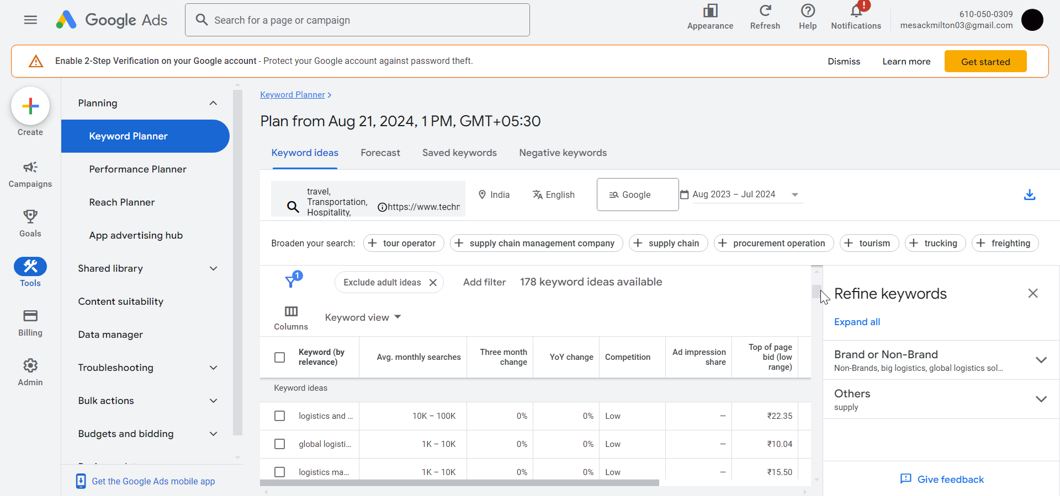
KEYWORD RESEARCH
1. High Volume & low competition Keywords
Targeted Keyword: Travel, Transportation, Logistics, and Hospitality
global logistics
logistics management
logistics services
transport near me
Transportation logistic
logistics business
road transport
management hospitality
Travel websites
Ministry of transportation
travel sites

Slide 65
Keywords for the TTLH Industry:
These keywords are directly related to the services provided by Tech Mahindra in the Travel, Transportation, Logistics, and Hospitality (TTLH) industries.
Primary Keywords
Travel Technology Solutions
Logistics Software Services
Hospitality IT Solutions
Transportation Management Systems
Smart Transportation Solutions
Digital Transformation in Logistics
IoT in Transportation
AI in Hospitality
Long-Tail Keywords
Custom logistics management software
AI-driven transportation solutions
Cloud computing in hospitality
Telecom IT for smart cities
Fleet management software for transportation
Data analytics in travel and hospitality
Automation in logistics and supply chain
Next-gen technology for travel industry

Slide 66
COMPETITOR KEYWORD ANALYSIS
Top Competitors:
Accenture: Known for digital transformation services in Travel industries.
Cognizant: Provides IT services and digital solutions targeting logistics and hospitality sectors.
TCS (Tata Consultancy Services): Offers solutions in transportation, logistics, and hospitality with a focus on digital integration.

Slide 67
Competitor Keywords and Strategies:
1. Accenture:
Keywords: "digital transformation in logistics," "supply chain automation," "travel technology solutions."
Strategy: Focuses heavily on digital transformation, cloud services, and AI across multiple industries, including TTLH. Accenture targets keywords around innovation and cutting-edge tech.
2. Cognizant:
Keywords: "logistics software development," "cloud services for hospitality," "AI in transportation."
Strategy: Leverages AI and cloud technologies. The content is heavily geared toward problem-solving and future-proofing businesses, focusing on digital adoption in TTLH.
3. TCS:
Keywords: "logistics automation," "IoT in transportation," "hospitality IT services."
Strategy: Uses highly targeted keywords with a focus on IoT, data analytics, and automation, which cater to evolving trends in TTLH sectors.

Slide 68
ON-PAGE SEO ANALYSIS
1. Title Tags, Meta Descriptions, and HTML Tags
a. Title Tags
a.1 Current Title Tag: “Travel, Transportation, Logistics, and Hospitality | Tech Mahindra”
a.2 Length: 66 characters
a.3 Analysis:
The title tag is descriptive, covering key industry terms. However, the abbreviation "TTLH" is used in the URL (/industries/ttlh/), which may impact SEO by making the URL less intuitive for search engines and users
Use a descriptive format, such as /industries/travel-transportation-logistics-hospitality/, to improve SEO performance and clarity for users.

Slide 69
b. Meta Description:
Current Meta Description: The selected page does not have a meta description
Analysis: Meta descriptions are crucial for improving CTR in SERPs. The absence of a meta description negatively impacts the page's search engine performance.
Recommendation:
Write a compelling meta description incorporating key phrases, highlighting Tech Mahindra's offerings for the TTLH industry:
Example: "Explore Tech Mahindra's digital solutions for Travel, Transportation, Logistics, and Hospitality (TTLH), driving innovation and efficiency for businesses worldwide."

Slide 70
C. HTML Tags (H1, H2, H3, etc.):
H1 Tag: "Travel, Transportation, Logistics, and Hospitality"
Analysis: The H1 tag is optimized for the main keyword.
Subheadings (H2, H3):
Strengths: The subheadings are descriptive and align with the content structure, though there could be more optimization by including secondary keywords.
Recommendation:
Use more specific H2 or H3 tags that integrate secondary keywords like “Digital Transformation in TTLH” or “Technology for Travel and Hospitality.

Slide 71
2. Keyword Usage in Content and Headings
The keyword “Travel, Transportation, Logistics, and Hospitality " is optimized in the heading
Based on the keyword distribution (heading is not included)
"Travel": 4 times
"Transportation": 3 times
"Logistics": 5 times
"Hospitality": 3 times

Slide 72
Analysis
While the individual components of the keyword "Travel, Transportation, Logistics, and Hospitality" are mentioned multiple times, their combined usage as a full phrase is only present once.
Is the Page Optimized?
The page is somewhat optimized due to the presence of individual terms spread throughout the content. However, the full phrase "Travel, Transportation, Logistics, and Hospitality" being used only once limits the overall optimization for that specific keyword. Search engines may recognize the relevance for individual industries (e.g., travel or logistics), but may not fully rank the page for the comprehensive keyword phrase
Content Depth: Content is somewhat general and lacks detailed explanations or case studies on specific solutions offered.

Slide 73
3. Internal and External Linking
a.3 Internal Links
Total links: 206
Internal Links: 197
Analysis: Integrate internal links within the content that direct users to related services or solutions offered by Tech Mahindra in the TTLH industry.
b.3 External Links
External Links: 9
Nofollow external: 5 (Others are Do follow)
Analysis: Include external links to trusted industry sources, such as government reports, industry whitepapers, or news articles.

Slide 74
4. Image Optimization Status
Images are properly optimized with alt texts, but their file names are generic
Recommendation
Rename image files to be more descriptive and keyword-rich.
Avoid using generic names (e.g., image1.jpg) and instead use specific, SEO-friendly names (e.g., tech-mahindra-cloud-solutions.jpg).
Use tools to reduce image file sizes without compromising quality.
Use lazy loading techniques to delay the loading of off-screen images until they are needed.

Slide 75
TECHNICAL SEO ANALYSIS
Overall Speed of the Desktop Webpage
Current Speed: 4.1 seconds (Largest Contentful Paint)
Recommended Speed: < 2.5 seconds
Overall Speed of the Mobile Webpage
Current Speed: 22.6 seconds (Largest Contentful Paint)
Recommended Speed: < 2.5 seconds

Slide 76
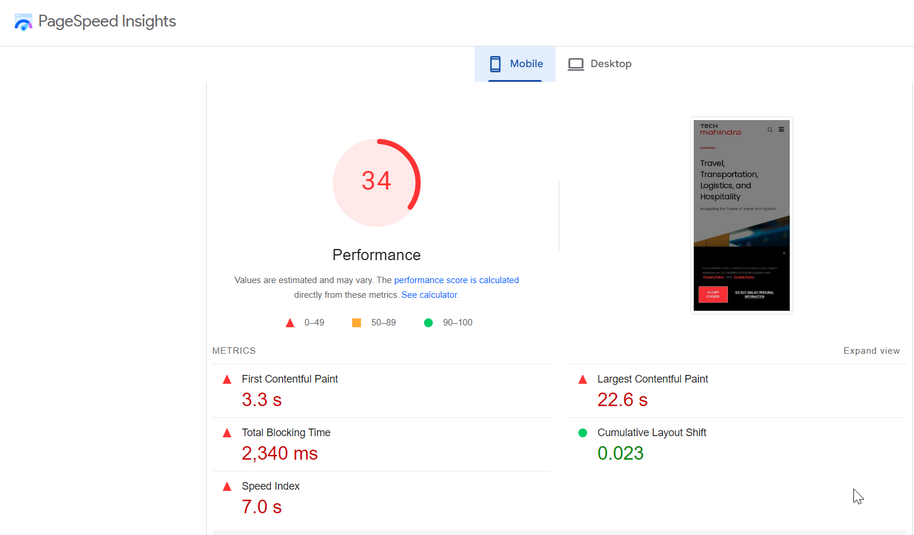
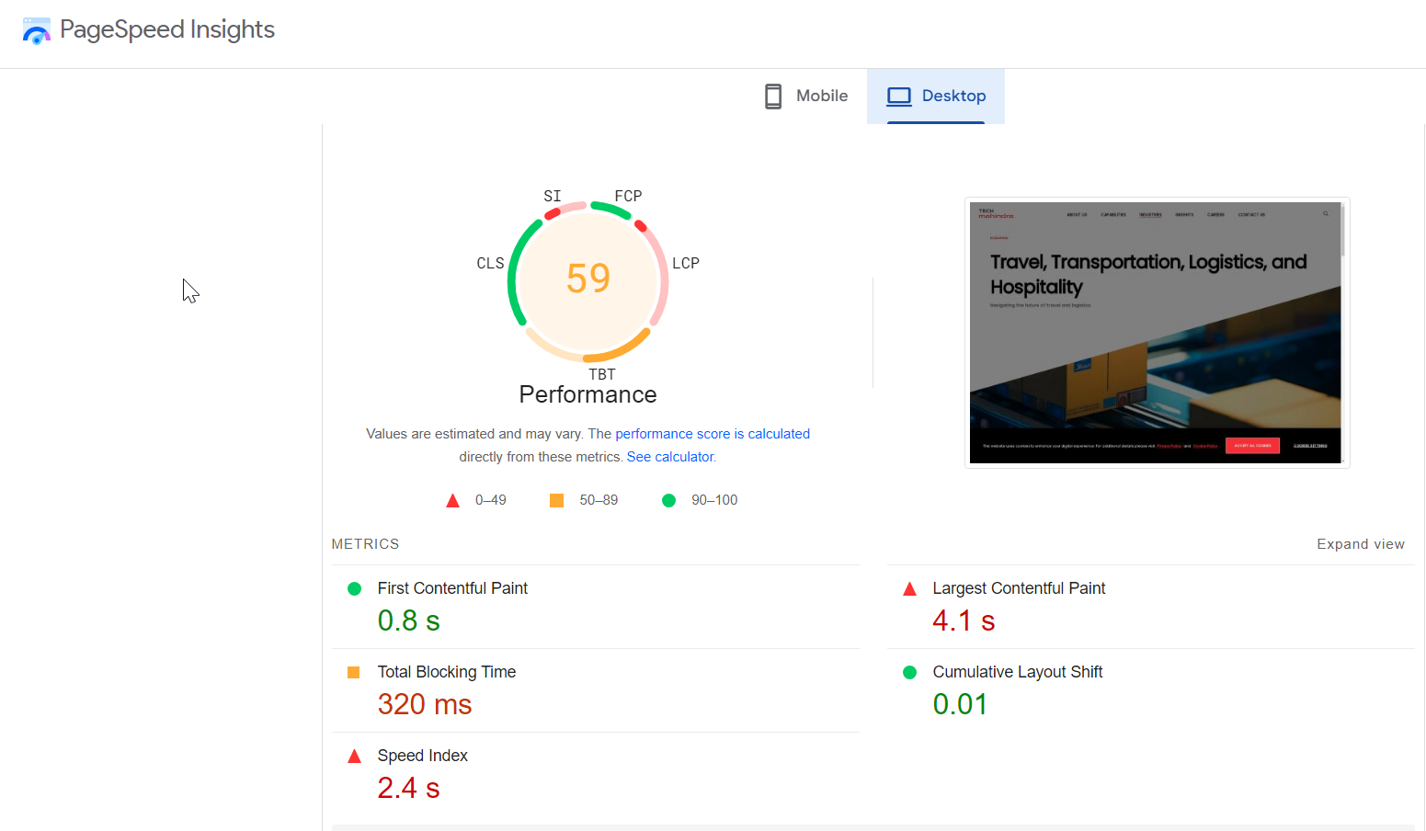
Mobile Score
Desktop score

Slide 77
5 Best Practices to Improve Site and Web Page Speed
Use image compression tools to reduce file sizes without sacrificing quality. Implement responsive images and serve different sizes based on the device.
Reduce the size of JavaScript and CSS files by minifying and combining them to decrease page load time.
Apply lazy loading to offscreen images and videos to reduce initial load time.
Optimize server performance by using efficient hosting solutions, optimizing databases, and utilizing server-side caching.
Improve by reducing render-blocking resources and focusing on enhancing the page’s visual loading efficiency.

Slide 78
CONTENT STRATEGY RECOMMENDATIONS
1. Optimize Homepage Content:
Update Headline: “Leading Travel, Transportation, Logistics, and Hospitality Solutions”
Expand Body Sections: Add detailed sections on Travel Technology, Transportation Management, Logistics Optimization, and Hospitality Technology.
2. Develop Targeted Blog Content:
Publish Articles: Focus on current trends and innovations in TTLH industries.
“Top Trends Shaping the Future of Travel Technology”
“How Intelligent Transportation Systems Are Revolutionizing Urban Mobility”
“Enhancing Supply Chain Efficiency with Advanced Logistics Solutions”
“Integrating Technology for Superior Guest Experiences”

Slide 79
3. Enhance FAQs and Glossary Sections:
FAQs: Address common questions about TTLH solutions.
“What are the benefits of travel technology solutions?”
Glossary: Define key industry terms.
“Intelligent Transportation Systems”
“Hospitality Management Systems”
4. Incorporate Visual and Interactive Content:
Infographics: “The Impact of Technology on TTLH Industries”
Videos: “Tech Mahindra’s TTLH Solutions Overview”

Slide 80
5. Promote Content via Social Media:
Share Content: Regularly promote blog posts, case studies, and white papers.
Engage with Industry Groups: Participate in relevant discussions and forums.
6. Leverage Email Marketing:
Newsletter: Include updates on TTLH solutions and highlights from blog posts and case studies.
Targeted Campaigns: Send tailored content to segmented email lists.

Slide 81
OFF-PAGE SEO ANALYSIS & STRATEGIES
1. Backlink Profile
Backlinks: The selected page does not currently have any direct backlinks.
Domain Backlinks: The Tech Mahindra domain has a strong backlink profile with numerous high-quality links, but these do not currently point to the TTLH page.
Quality Backlinks:
Secure backlinks from authoritative industry sites and journals related to travel, transportation, logistics, and hospitality.
Write guest posts for high-authority blogs and websites in TTLH sectors, including a link back to the TTLH page.
Collaborate with industry partners for link placements in their content

Slide 82
2. Content Marketing and Promotion
Share comprehensive white papers and case studies with a focus on TTLH sectors. Promote them through industry platforms and networks.
Produce visually engaging infographics and videos about TTLH topics and promote them on relevant platforms.
Share TTLH-related content across Tech Mahindra’s social media channels, engaging with industry-specific groups and hashtags.
Collaborate with industry influencers to share and promote content.
Organize webinars on TTLH topics and include links to the TTLH page in promotional materials.

Slide 83
3. Social Signals and Community Engagement
Post regular updates and insights related to TTLH on Tech Mahindra’s social media accounts.
Respond to comments, questions, and discussions related to TTLH content.
Join and actively participate in industry-specific forums and groups, providing valuable insights and linking back to the TTLH page where relevant.
Engage in Q&A platforms like Quora or Reddit, addressing TTLH-related questions and linking to the TTLH page.

Slide 84
THANK YOU

